Slide 1

ME 203 Introduction to MATLAB
‹#›

Slide 2
Review
Run MATLAB
User interface
Create and run a script file
Help
Hints for working in the Command Window
Open the Function browser (shift F1)
The clc command
Clears the command window
The clear command
Clears the workspace
Use 🡩 🡫keys to scroll through entered commands and rerun.
help will tell you how to use a function and what it does.
(e.g. to get help on the Plot function >> help plot )

Slide 3
Other useful things…
F5 runs program
Use 🡩 🡫keys to scroll through previously entered commands and rerun.
Arrow up and press enter
who: lists the names of defined variables
whos: lists the names and sizes of defined variables
close all: closes all plot windows
clf: clears the current figure and thus clears the graph window

Slide 4
Scalar Mathematics
A scalar is a single number without direction
Operation Algebraic form Matlab Example
Addition a + b a + b 5 +3
Subtraction a − b a - b 23-12
Multiplication a × b a * b 3.14*0.85
Right division a ÷ b a / b 56/8
Left division b ÷ a a \ b 8\56
Exponentiation a^{b} a ^ b 5 ^2

Slide 5
Scalar Mathematics
Order of Operations (or use of parenthesis) is important
Examples
6*5-5
=25
6*(5-5)
=0
Precedence | Math Function
First | Parenthesis
Second | Exponentiation
Third | Multiplication and Division
Fourth | Addition and Subtraction

Slide 6
Variables and Assignment Statements
Rules for variable names :
• Must start with a letter
• May consist only of the letters a-z, digits 0-9, and the underscore character (_)
• May be as long as you would like, but Matlab only recognizes the first 31 characters
• Is case sensitive: items, Items, itEms, and ITEMS are all different variable names.
• A variable cannot be used in a statement until it is defined

Slide 7
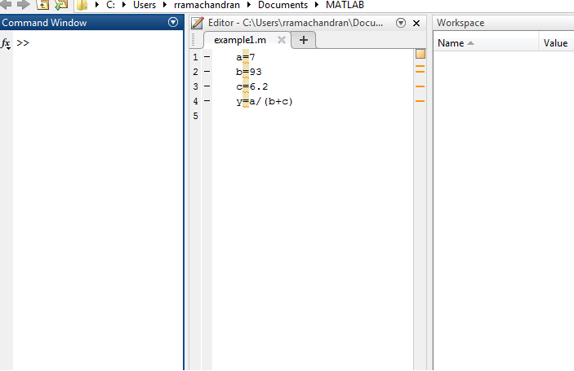
Example: Defining Variables
Calculate y given y=a/(b+c) where a=7, b=93 and c=6.2

Slide 8
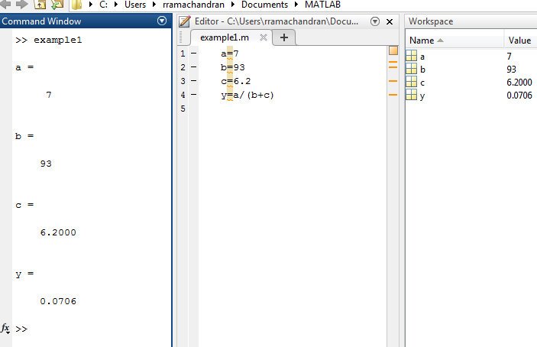
Example: Defining Variables
Calculate y given y=a/(b+c) where a=7, b=93 and c=6.2

Slide 9
Comments
Percentage Sign (%)
When the % symbol is typed at the beginning of a line, the line is considered a comment
Comment lines are not executed
Example: All HW code should start with your name
% Austin Lopez
% ME 203, Section 1101
% Lab 4
You can comment or uncomment multiple lines by highlighting them and using the following commands
Ctrl R comments the line
Ctrl T uncomments the line

Slide 10
Punctuation
Semicolons (;)
Type at the end of the command when you do not want to see the output
Can be useful when you don’t want to see all the small steps
Commas and semicolons can be used to place multiple commands on one line
commas display the results
semicolons suppress the results
Three periods (. . .) at the end of a command indicates that the command continues on the next line. A continuation cannot be given in the middle of a variable name.

Slide 11
Code Structure
Problem description
Format workspace
Given information
Preliminary Calculations (If needed)
Initialize variables (If needed)
Calculations
Display Answer (This may be done in the calculations)

Slide 12
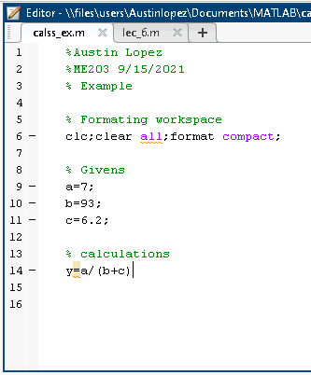
Example: Defining Variables
Calculate y given y=a/(b+c) where a=7, b=93 and c=6.2

Slide 13
Displaying Values and Text
There are three ways to display values and text in Matlab
1. By entering the variable name at the Matlab prompt (or in a script), without a semicolon
2. By use of the command disp
3. By use of the command fprintf

Slide 14
Disp() Command
1. disp(variable): Displays value of variable without displaying the variable name.
2. disp(string): Displays string by stripping off the single quotes and echoing the characters between the quotes.
>> temp=78;
>> disp(temp); disp(’degrees F’)
78
degrees F
Output:

Slide 15
fprintf Command
fprintf gives more control on the appearance of what is displayed
fprintf(’format string’, list of variables)
Example:
>> fprintf('The temperature is %f degrees F \n', temp)
The temperature is 78.000000 degrees F
Output:
%f Inserts variable here (uses default number formatting)
\n Newline (skip to beginning of next line)

Slide 16
fprintf Command
The percentage sign (%) in case of fprintf is not a comment
It is used to specify how to format the output displayed
>> fprintf('The temperature is %f degrees F \n', temp)
Specifier | Description
%c | Single character
%s | String
%d | Decimal number (signed)
%f | Floating-point number
%e | Exponential notation (using a lowercase e as in 3.1415e+00)
%E | Exponential notation (using an uppercase E as in 3.1415E+00)
%% | Print a percentage sign
\n | Go to new line
\t | Print a tab
\\ | Print a slash

Slide 17
fprintf Command
Controlling the width and precision of output
Example:
>> fprintf(’The temperature is %4.1f degrees F \n’, temp)
The temperature is 78.0 degrees F
>> fprintf('The temperature is %4.1e degrees F \n', temp)
The temperature is 7.8e+01 degrees F
Width: minimum number of characters in the output (includes decimal points and negative signs)
%x.xf
Precision: number of digits to be printed to the right of the decimal point
Exponential notation: %x.xe
Note: e+0 are not counted in the character count

Slide 18
fprintf Command
Example:
hot = 95; cold = 45;
fprintf('The hot temperature is %4.1f degrees F and the cold temperature is %4.1f degrees F \n', hot, cold)
Output:
The hot temperature is 95.0 degrees F and the cold temperature is 45.0 degrees F
Note: The variables are inserted into the output string in the same order they are listed in fprintf()

Slide 19
Variable redefinition
>> screws = 32;
>> bolts = 18;
>> rivets = 40;
>> items = screws + bolts + rivets
items =
90
>> screws = 36
screws =
36
>> items
items =
90
Note that the value of items has not changed.

Slide 20
Special variables:
ans: default variable name
pi: ratio of circle circumference to its diameter, π = 3.1415926...
eps: smallest amount by which two numbers can differ
inf or Inf : infinity, e.g. 1/0
nan or NaN : not-a-number, e.g. 0/0
date: current date in a character string format, such as 19-Mar-1998.

Slide 21
Basic Mathematical Functions
abs(x) Absolute value |x|
sign(x) Sign, returns −1 if x < 0, 0 if x = 0, 1 if x > 0
exp(x) Exponential e^{x}
log(x) Natural logarithm ln x
log10(x) Common (base 10) logarithm log₁₀ x
sqrt(x) Square root √x
rem(x,y) Remainder of x/y. For example, rem(100,21) is 16. Also called the modulus function.

Slide 22
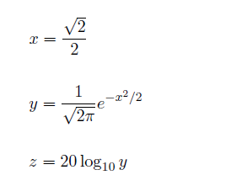
Example: Basic Functions
>> x = sqrt(2)/2
x =
0.7071
>> y = exp(-(x^2)/2)/sqrt(2*pi)
y =
0.3107
>> z = 20*log10(y)
z =
-10.1533

Slide 23
Other useful things…
Use parentheses often
Use multiple statements
Consider the equation:
H(s) = s² + 4s + 13
s³ − 2s² + 4s + 5
Matlab commands:
numerator = s^2 + 4*s + 13;
denominator = s^3 - 2*s^2 + 4*s + 5;
H = numerator/denominator;

Slide 24


Slide 25
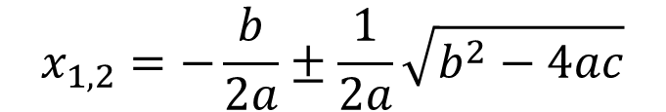


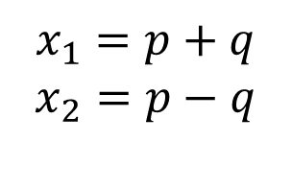
Example: Solving for quadratic roots
Solve for x: 2x² + 10x + 12 = 0
General form: ax² + bx + c = 0
Solution
Format solution to type into MATLAB

Slide 26
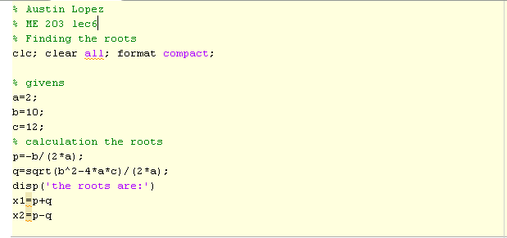
Continued…

Slide 27
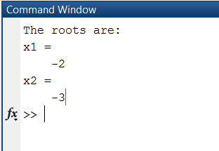
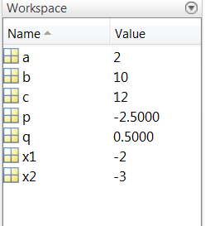
Continued…

